Slide 1
Welcome to BUS-660 Quantitative Methods
Dr. Alex Casteel
alex.casteel@gcu.edu
(480) 694-0662
@dralexcasteel
@alexcasteel

Slide 2
Administration
TOPIC
Participation in DQs & Class
Homework

Slide 3
Introduction to Linear Programming and Sensitivity Analysis
What is it?
Using a set of known constraints to reach an optimal outcome

Slide 4
Example
RMC, Inc., is a small firm that produces a variety of chemical-based products. In a particular production process, three raw materials are used to produce two products: a fuel additive and a solvent base. The fuel additive is sold to oil companies and is used in the production of gasoline and related fuels. The solvent base is sold to a variety of chemical firms and is used in both home and industrial cleaning products. The three raw materials are blended to form the fuel additive and solvent base. One ton of fuel additive is a mixture of 0.4 tons of material 1 and 0.6 tons of material 3. A ton of solvent base is a mixture of 0.5 tons of material 1, 0.2 tons of material 2, and 0.3 tons of material 3.
Maximize the profit if there is a profit contribution of $40 for every ton of fuel additive produced and $30 for every ton of solvent base produced.

Slide 5
Linear Programming & Sensitivity Analysis
Problem formulation
Graphical Approaches
Solver-based solutions
Sensitivity analysis

Slide 6
Problem Formulation
Identifying the desired outcome of the problem and understanding and using all the problem boundaries to arrive at the correct solution

Slide 7
Problem Formulation
Understand the problem thoroughly
Describe each objective
Describe each constraint
Define the decision variables
Write the objective in terms of the decision variables
Write the constraints in terms of the decision variables
Add the negativity constraints

Slide 8
Problem Formulation
Understand the problem thoroughly
Read through the problem
Read through the problem again
Visualize the scenario as if you were the manager

Slide 9
Problem Formulation
Describe each objective
The objective is typically to maximize or minimize a function, such as maximizing profits or minimizing costs

Slide 10
Problem Formulation
Describe each constraint
Constraints are the boundaries or requirements placed upon the analysis by availability of resources, product or service requirements, desired outcomes, or other restrictions placed upon the system.

Slide 11
Problem Formulation
Define the decision variables
The decision variables are the controllable inputs for the problem

Slide 12
Problem Formulation
Write the objective in terms of the decision variables
The objective is the desired outcome and is developed as a function of the decision variables (see step 4)
If you are struggling to identify the decision variables, begin writing your best guess of the objective function. The decision variables will tend to identify themselves as you do this.

Slide 13
Problem Formulation
Write the constraints in terms of the decision variables
Express the constraint identified in step 3 in terms of the decision variables identified in step 4. Constraints are expressed as mathematical statements.

Slide 14
Problem Formulation
Add the negativity constraints
Because most decision variables may not be a negative value, these constraints must be identified.

Slide 15
Problem Formulation
Understand the problem thoroughly
Describe each objective
Describe each constraint
Define the decision variables
Write the objective in terms of the decision variables
Write the constraints in terms of the decision variables
Add the negativity constraints

Slide 16
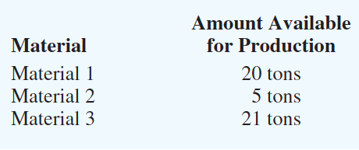
Example Step 1 – Understand the problem

Slide 17
Example Step 2 – Describe the objective
Maximize profits based upon profit contributions of $40/ton for fuel additive and $30/ton for solvent base.

Slide 18
Example Step 3 – Describe each constraint
The number of tons of material 1 used must be less than or equal to the 20 tons available.
The number of tons of material 2 used must be less than or equal to 5 tons available
The number of tons of material 3 used must be less than or equal to 21 tons available

Slide 19
Example Step 4 – Define the decision variables
F = number of tons of fuel additive
S = number of tons of solvent base

Slide 20
Example Step 5 – Write the objective in terms of the decision variables
Total profit contribution = 40F + 30S

Slide 21
Example Step 6 – Write the constraints in terms of the decision variables
The number of tons of material 1 used must be less than or equal to the 20 tons available.
Tons of material 1 used ≤ Tons of material 1 available
Tons of material 1 used = 0.4F + 0.5S
0.4F + 0.5S ≤ 20
Exercise:
Write constraints 2 and 3

Slide 22
Example Step 6 – Write the constraints in terms of the decision variables
The number of tons of material 2 used must be less than or equal to the 5 tons available.
Tons of material 2 used ≤ Tons of material 2 available
Tons of material 2 used = 0.2S
0.2S ≤ 5
Exercise:
Write constraints 2 and 3

Slide 23
Example Step 6 – Write the constraints in terms of the decision variables
The number of tons of material 3 used must be less than or equal to the 21 tons available.
Tons of material 3 used ≤ Tons of material 3 available
Tons of material 3 used = 0.6F + 0.3S
0.6F + 0.3S ≤ 21
Exercise:
Write constraints 2 and 3

Slide 24
Example Step 7 – Add non-negativity constraints
RMC cannot produce a negative amount of fuel additive (F) or solvent base (S); therefore,
F ≥ 0 and S ≥ 0
F, S ≥ 0

Slide 25
Example Mathematical model
Max 40F + 30S
Subject to (s.t.)
0.4F + 0.5S ≤ 20 Material 1
0.2S ≤ 5 Material 2
0.6F + 0.3S ≤ 21 Material 3
F, S ≥ 0

Slide 26
Are we done?
Now it is time to find the optimal solution!

Slide 27
Graphical Approaches
By graphing the constraints and then testing the critical points, one may determine the optimal solution
Graphical solution procedure for maximization problems
Prepare a graph for each constraint that shows the solutions that satisfy the constraint.
Determine the feasible region by identifying the solutions that satisfy all the constraints simultaneously.
Draw an objective function line showing the values of the decision variable that yield a specified value of the objective function.
Move parallel objective function lines toward larger objective function values until further movement would take the line completely outside the feasible region.
Any feasible solution on the objective function line with the largest value is an optimal solution.

Slide 28
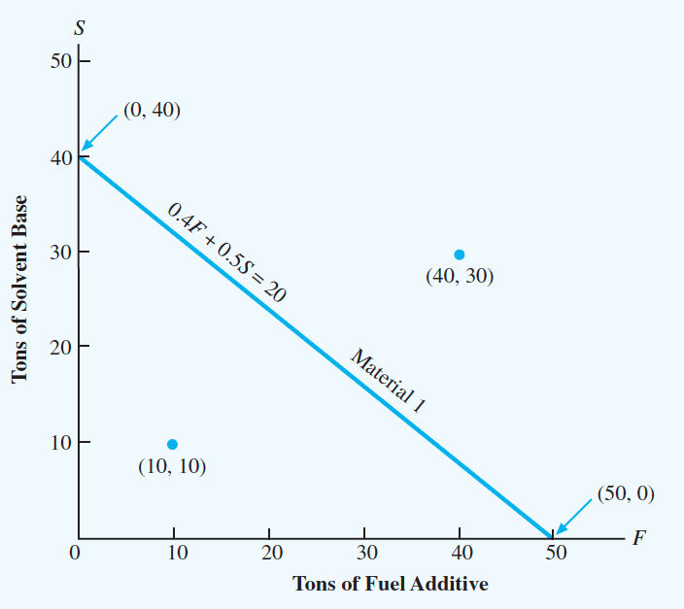
Graphical Approaches Material 1 Constraint line Begin to define feasibility region
Feasibility Region

Slide 29
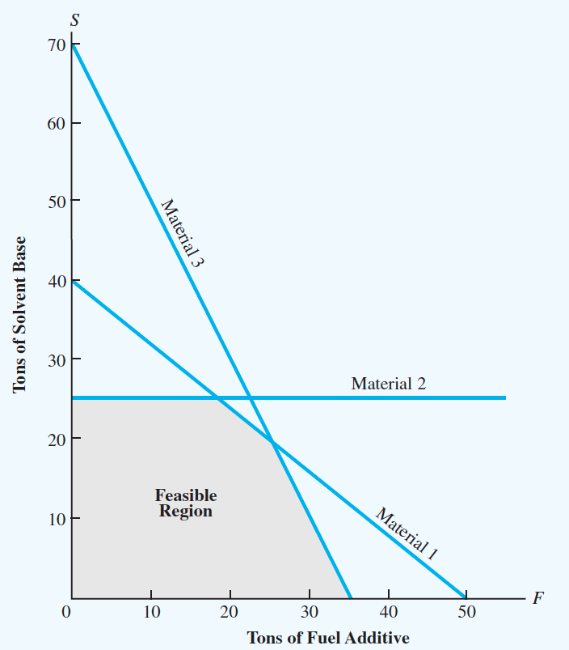
Graphical Approaches Material 1 Constraint line Material 2 Constraint line Material 3 Constraint line Feasibility region is defined by the constraints and includes all possible outcomes

Slide 30
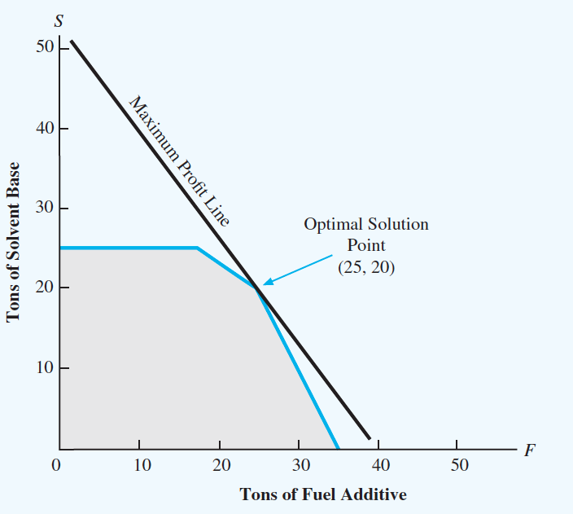
Graphical Approaches Plot the Maximum Profit Line Max 40F + 30S

Slide 31
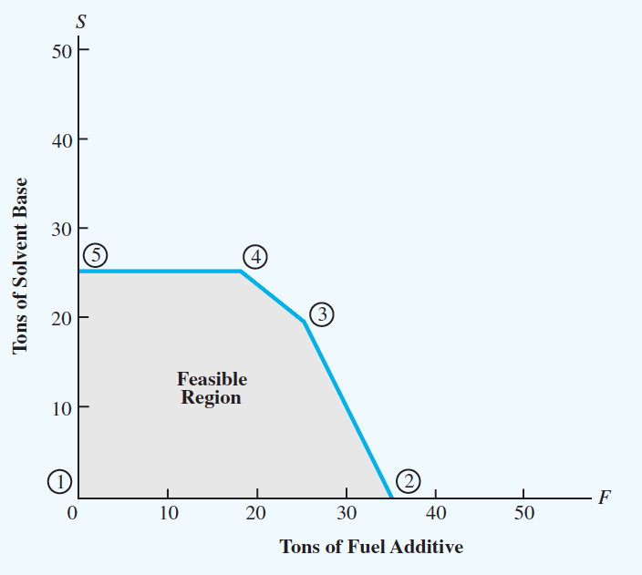
Graphical Approaches Plot the Maximum Profit Line The intersection will occur at one of five extreme points

Slide 32
Solver-based Solutions
RMC
 | Fuel Additive | Solvent Base
Amount to produce | 25 | 20
Constraints | Material Requirements
Material | Fuel Additive | Solvent Base | Used |  | Available
Material 1 | 0.4 | 0.5 | 20 | ≤ | 20
Material 2 | 0 | 0.2 | 4 | ≤ | 5
Material 3 | 0.6 | 0.3 | 21 | ≤ | 21
Profit Per Ton | 40 | 30
Objective |  |  | Total
Maximize | 40 | 30 | 1600
Module 3.Class Examples.xlsx

Slide 33
Minimization Solutions
Describe the objective
Module 3.Class Examples.xlsx > M&D Chemicals

Slide 34
Sensitivity Analysis
Sensitivity analyses allow one to determine how much a single Objective Function Coefficient may change without changing the Optimal Solution
Notes:
Sen

Slide 35
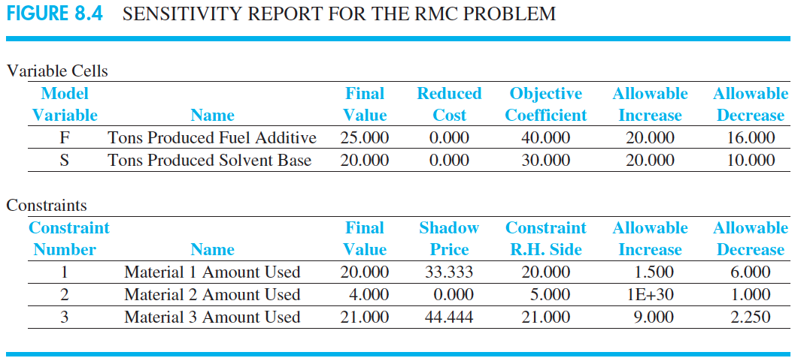
Sensitivity Analysis
Objective coefficients of 40 for F and 30 for S lead to a solution of 25 tons of F and 20 tons of S. Should the profitability of one coefficient change (let’s use F), does the optimal solution of F = 25 and S = 20 change?
Objective coefficient 40 + 20 max or 40 – 16 (min) requires no change to the optimal solution. Therefore, provided 24 ≤ F ≤ 60, then F = 25, S = 20 will still maximize profits.
What is the allowable range for the S objective coefficient to maintain the optimal solution for maximum profit?
20 ≤ S ≤ 50

Slide 36
Linear Programming & Sensitivity Analysis
Problem formulation
Graphical Approaches
Solver-based solutions
Sensitivity analysis

Slide 37
Additional Resources
Complete summary, including graphical solution, solver, and sensitivity analysis
https://youtu.be/m1OAo7W1FIk
Linear Programming (LP) Sensitivity Analysis – Interpreting Excel’s Solver Report
https://youtu.be/FzY333RdrBM

Slide 38
Looking Ahead
Topic 3 DQ 1
Topic 3 DQ 2
Topic 3 Homework
Linear Programming: Applications in Marketing, Finance, and Operations Management
Midterm exam

Slide 39
Dr. Alex Casteel
alex.casteel@gcu.edu
(480) 694-0662 (text or call)
Halo Messaging

